Slide 1


MDVR Problems and solutions

Slide 2

Index
Security
Encrypt the HDD and SD card.
Change USB to USB-C.
Remove Qnap lock power off function.
Scan HDD/SD integrity and lifespan.
Add barcode to each PCB board sent to us.
Change 6-digit password.
Minimise HDD/SD card errors.
Log SIM mobile phone number in CMS.
User-Friendliness
Connect laptop to configure MDVR-XXXX.
Dump log file once a day to server.
Tools to flash O.S to device and copy of O.S.
Gerber files and schematic of device for fault finding.
Testing equipment for repaired devices.
Function to FTP into device.
Support for Busybox and Das u-boot understanding.
Sending parameter messages to many devices at once.
On CMS, SMS’s window style box to display received SMS.
S500 device and other device options.
Loading screen to be changed to SAFE-TVIGIL Loading…

Slide 3
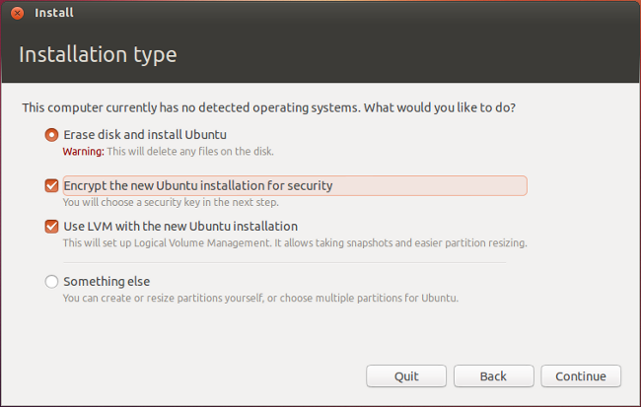
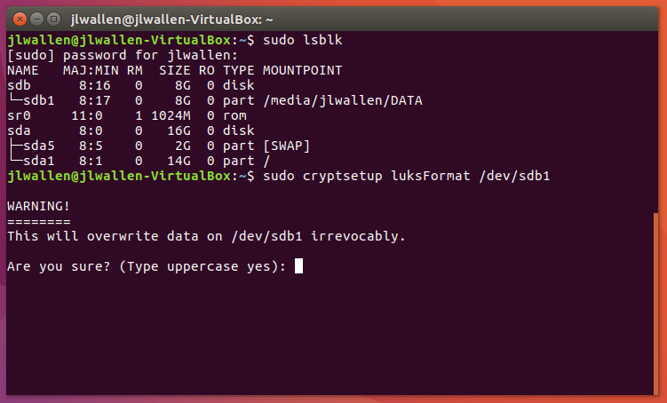
Encrypt the HDD and SD card.
We need to encrypt the devices drives or apply a password requirement.
This is needed because criminals will erase the content of the drive.
Also we have contracts with security company’s who require this.
We have also had other company’s steal our product.

Slide 4
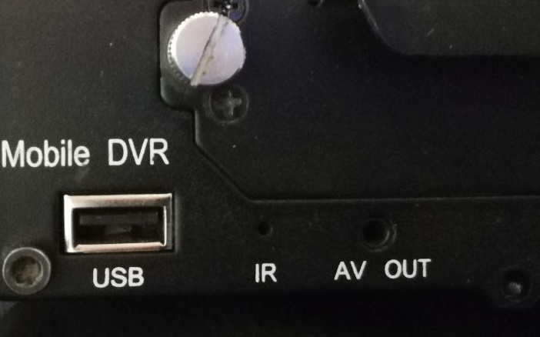
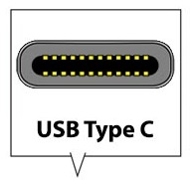

Change USB to USB-C.
We need the USB port however, we want it to be USB-C.
This is so that the drivers can’t plug in phone charger to device.
Also the drivers are more likely to tamper with normal USB.
The USB port must also have a lock function.

Slide 5
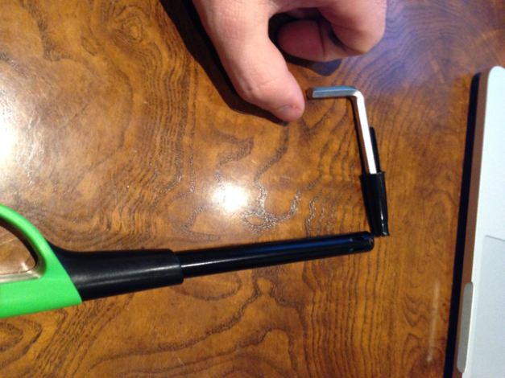
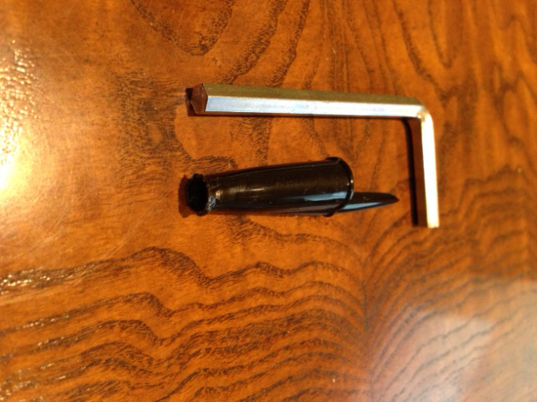
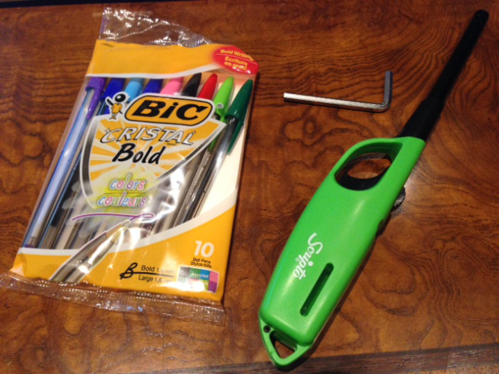
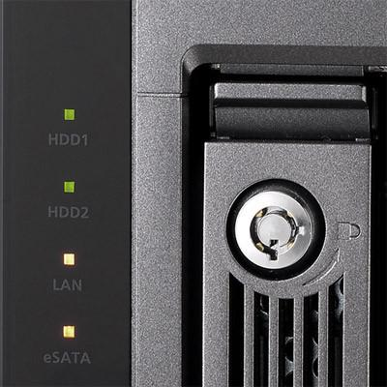
Remove Qnap lock power off function.
The device’s lock power off function needs to be removed.
Drivers can easily tamper with the device’s Qnap.
For this reason we need to improve the lock or remove it.

Slide 6
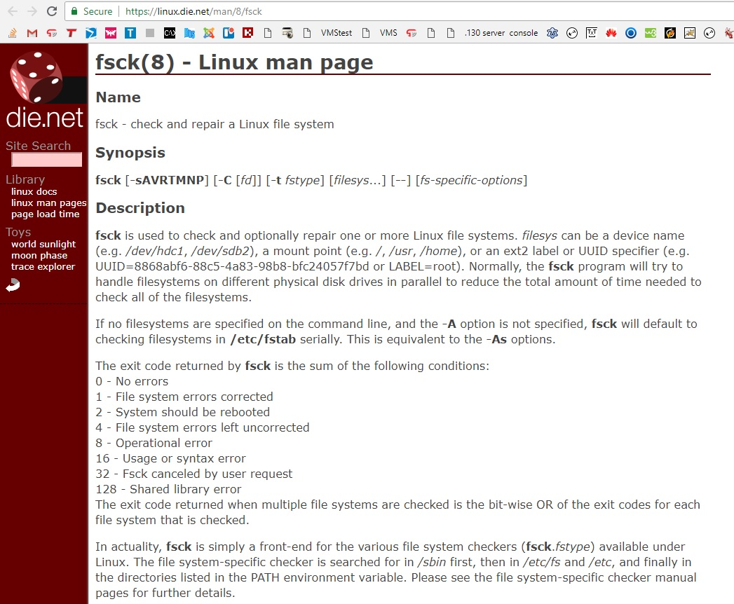
Scan HDD/SD integrity and lifespan.
The storage lifespan needs to be scanned in the device.
We need to determine the health of the HDD and SD.
This is important for client satisfaction and security.
Example is the Linux fsck command.
You can use the Busybox equivalent.

Slide 7
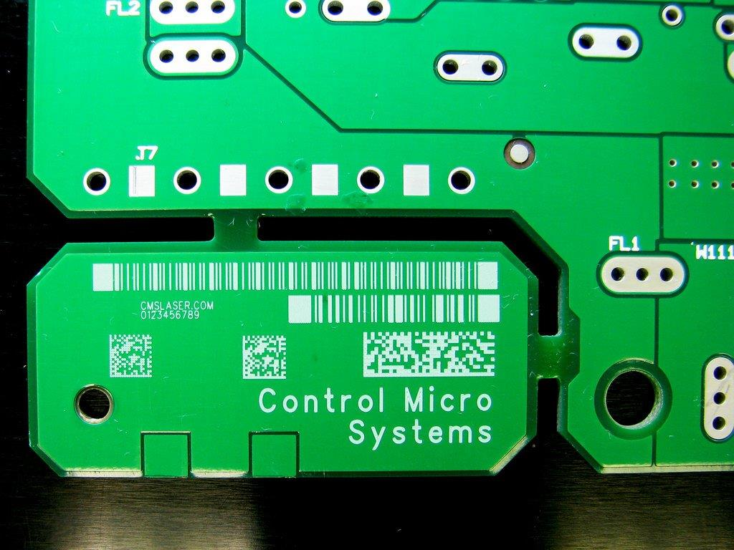
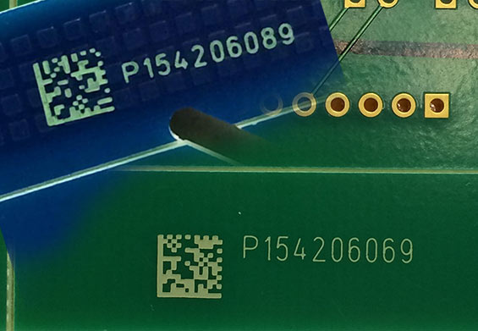
Add barcode to each PCB board sent to us.
Each PCB board sent to us must have a barcode printed barcode.
This is needed for stock control and for general stock keep.

Slide 8
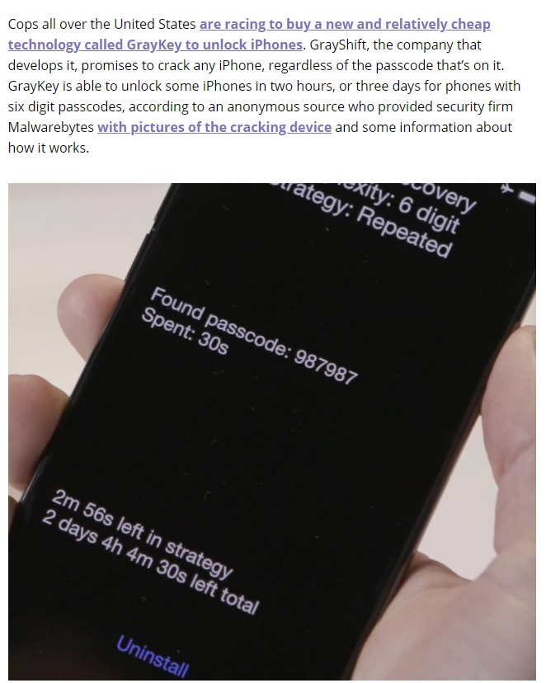
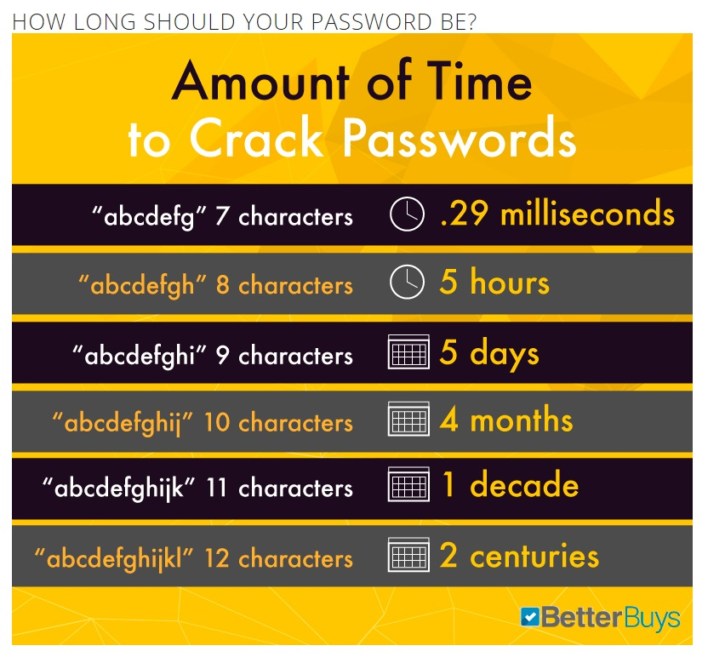
Change 6-digit password.
The 6-digit password on the device is extremely vulnerable.
This needs to be changed moving forward to insure security.
Link1 Link2

Slide 9
Minimise HDD/SD card errors.
T17051603 Firmware does not report a HDD error.
Device stops recording and there is no alarm.
The device can have a HDD error if the GPIB pins do not connect properly.
Old HDD’s with dirt/dust cause heat and the HDD can become faulty.
The HDD & SD should be replaced at least 1 time each year to ensure that the devices are kept optimal.
SSD drives will greatly improve the reliability of the device’s storage. No moving parts etc.
HDD’s need to have a monitoring application on the device’s O.S.
Sometimes HDD & SD need to be formatted for the snapshots to work.

Slide 10
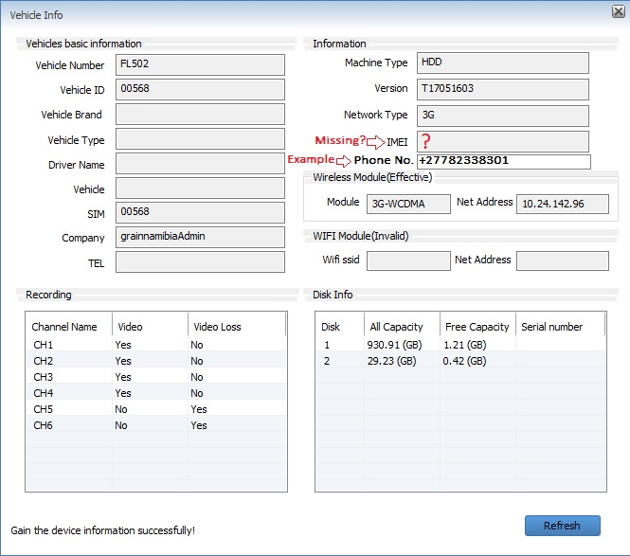
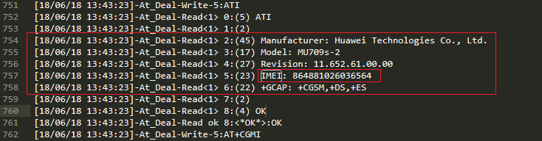
Log SIM mobile phone number in CMS.
We need to know what SIM card IMEI and number is in the device at all times.

Slide 11
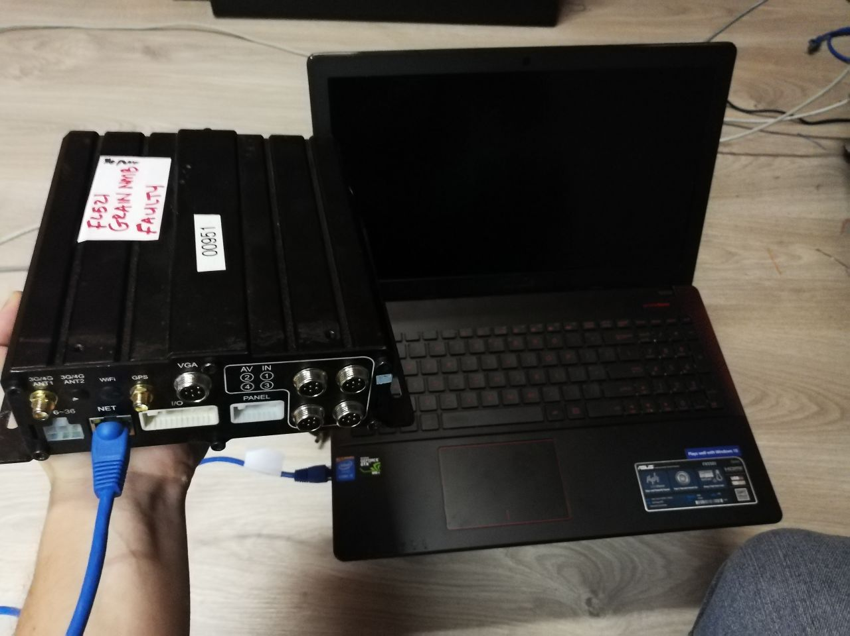
Connect laptop to configure MDVR-XXXX.
We need to be able to configure the device by physically plugging in a LAN cable.
This is needed to setup devices on a large scale.
This method will also prove to be efficient with our technicians.

Slide 12
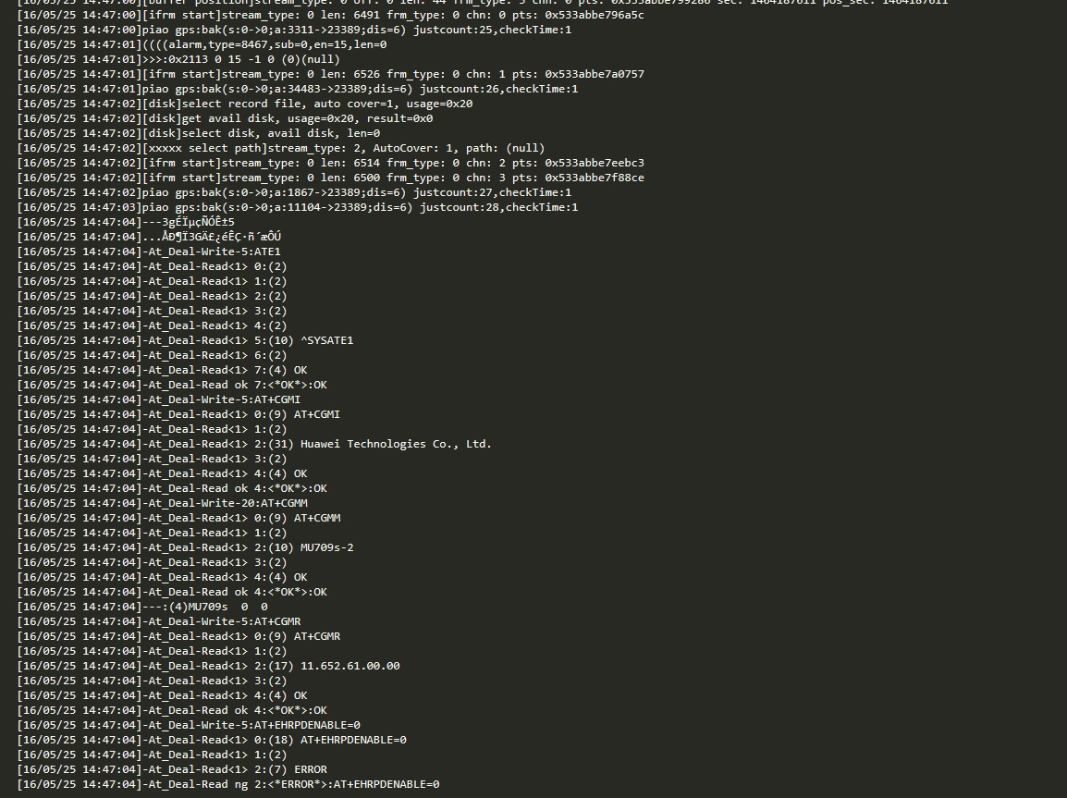
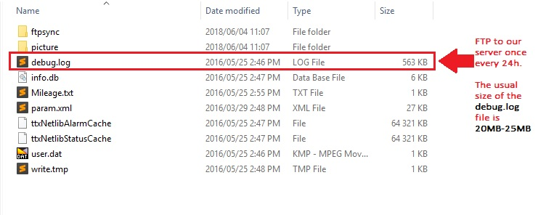
Dump log file once a day to server.
We need to monitor device log files in order to troubleshoot current and potential problems.
The debug.log and debug.log.bak files are very useful. Especially when a client requires information when a device is not working correctly.
Therefore we need the device to send a log file via FTP to our server everyday. We have enough space and will delete logs older than 3 months.

Slide 13
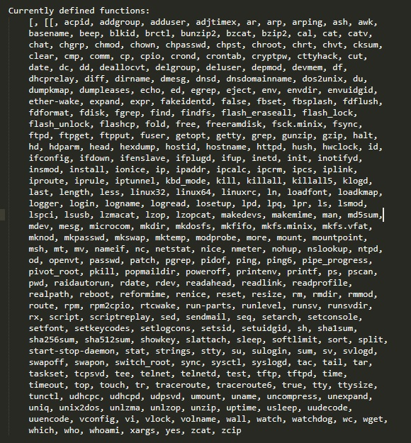
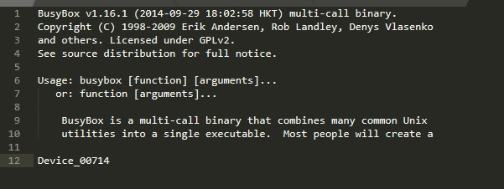
Tools to flash O.S to device and copy of O.S.
We need to be able to re-flash the device with it’s O.S in the case where the device is slow or not working properly.
This is necessary in the fault finding process and it will prevent the cost of shipping back faulty devices which could have been fixed in South Africa.
Das u-boot bootloader and Busybox embedded Unix tools. $: busybox | head

Slide 14
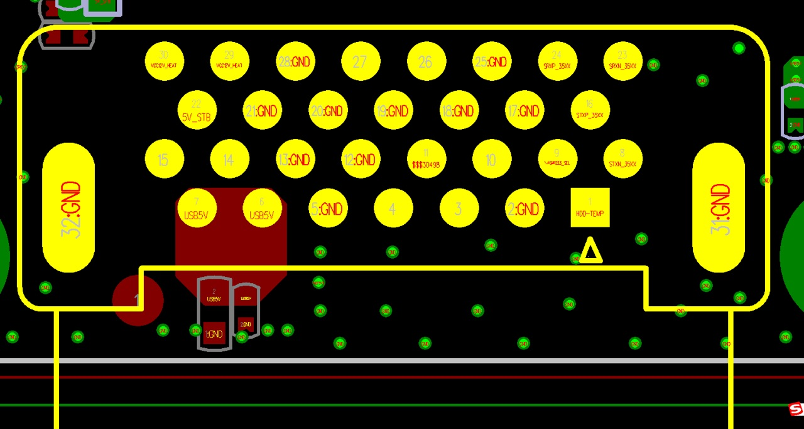
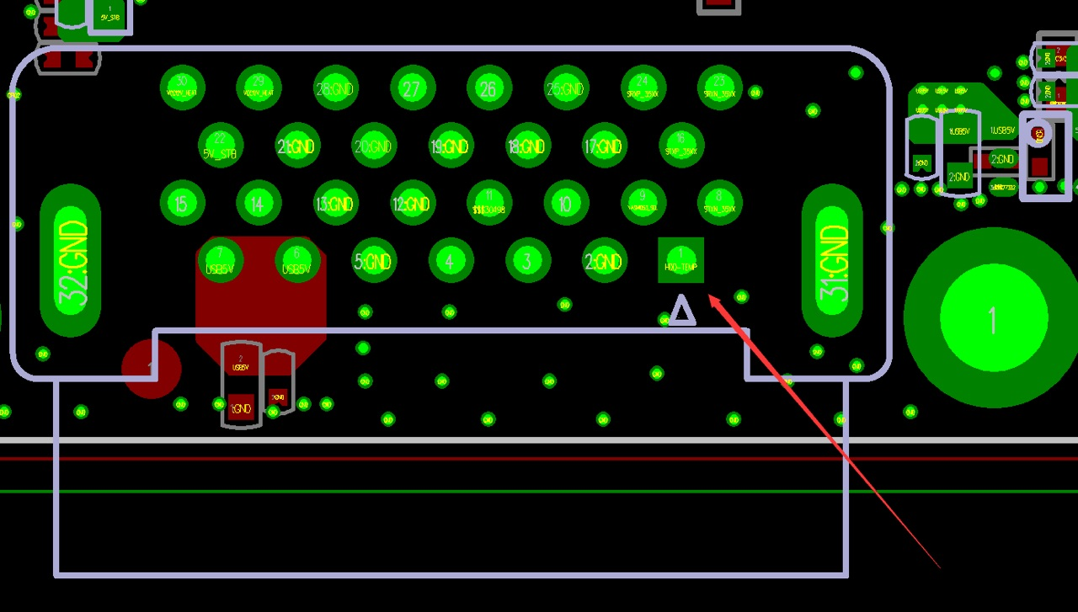
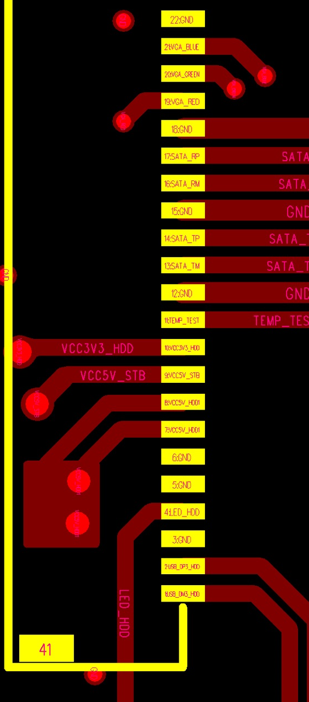
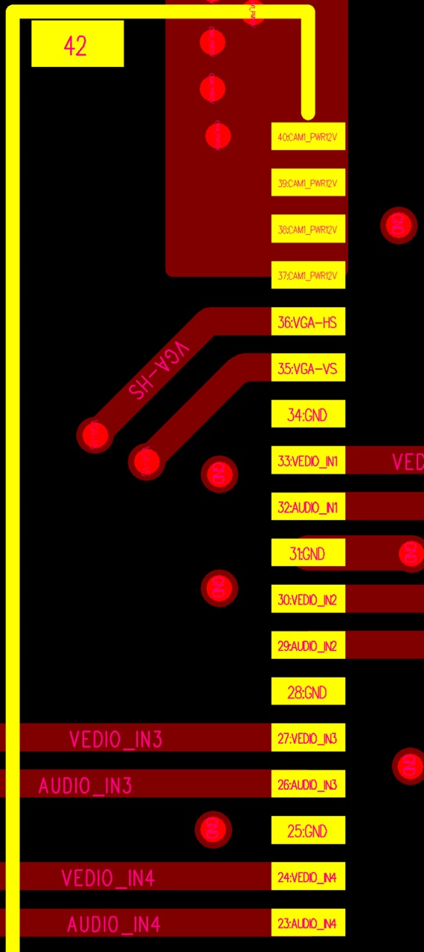
Gerber files and schematic of device for fault finding.
The devices schematic diagram is needed for when we need to do fault finding on the device.
This will improve the understanding of the devices function and features.
Improve sales as clients want a professional explanation of a problem when their device is faulty.

Slide 15
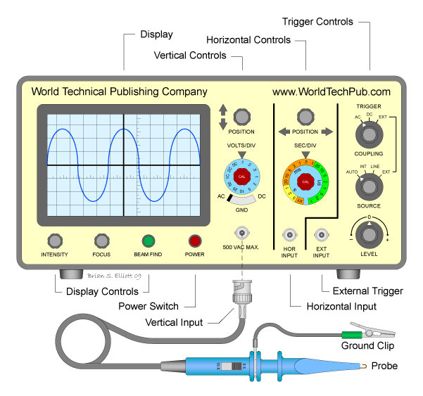
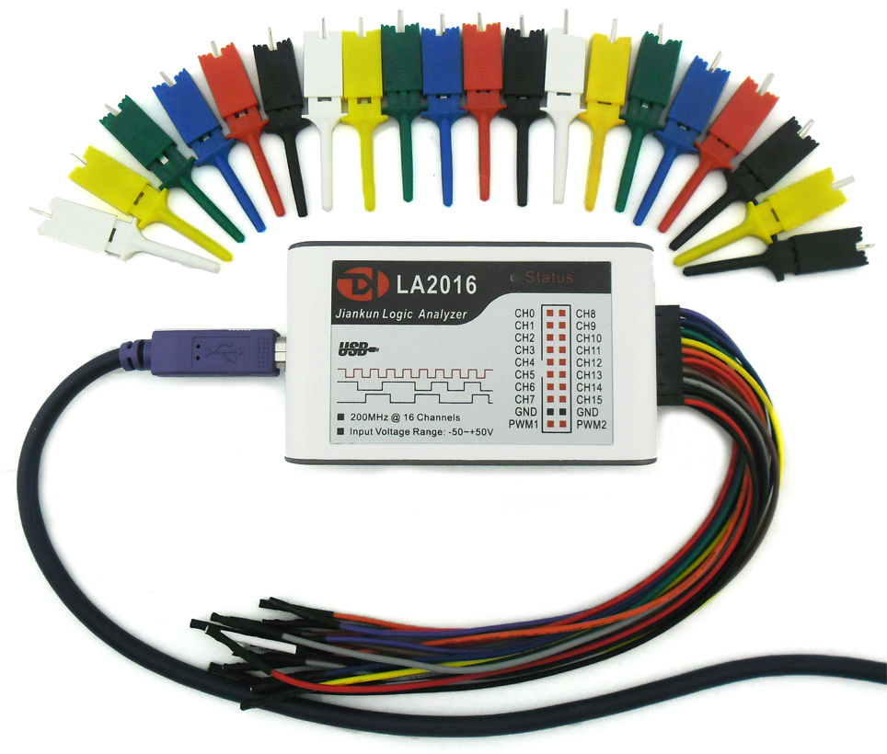
Testing equipment for repaired devices
We need to get some of the equipment which is used in the factory to test the devices.
For example: we would need a logic analyser and other tools used to test the devices boards and components.
Oscilloscope
Logic analyser

Slide 16
Function to FTP into device.
We need to be able to FTP into the device to view the directory’s and content.
This is imperative once the device has had a fault fixed because we need to check that the device is functioning properly. Also it offers us the opportunity to find the source of the problem so that we can create a report for the client giving them a valid reason.

Slide 17
Support for Busybox and Das u-boot understanding.
We want to have access to the U-Boot bootloader and to the Busybox embedded software and support from china to troubleshoot the device’s hardware and the software issues.
This will help in understanding how the device works and in turn will allow us to give the customer a better quality of service ,thus increasing the reputation of Truck Assist and your company’s product and in doing this sales for the device will increase above our competitors.

Slide 18
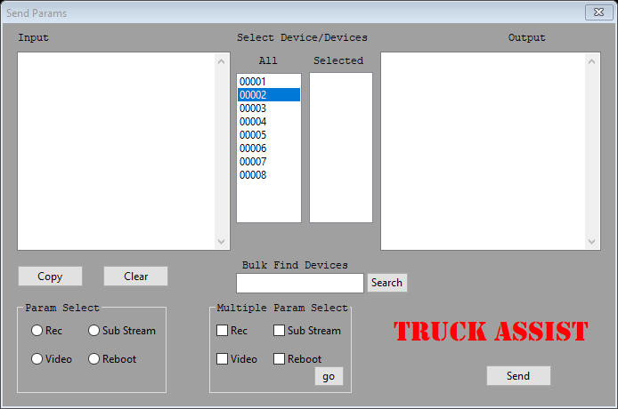
Sending parameter messages to many devices at once.
I have created a small demo example of how to send parameters to multiple devices at once.
This can be used as a tool to ease the work load, in fact this will be mandatory in future especially with a large volume of devices, it will be impossible to send a parameter once at a time. See video below.

Slide 19
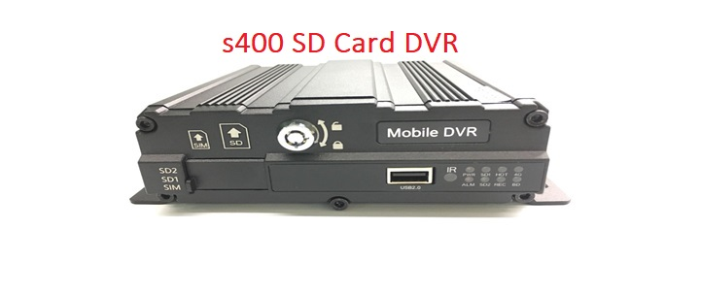
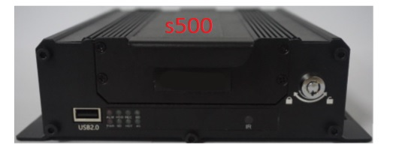
S500 device and other device options.
We need to look at options of improved devices which have already been built.
Improved software, hardware, speed, and durability.
The s500 device has more RAM and is faster then the older devices however the log file is very brief and we need a thorough log file.

Slide 20

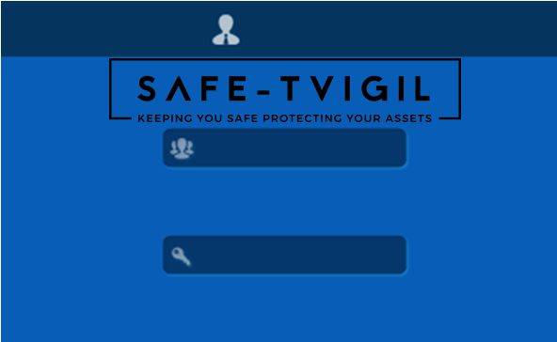
Truck Assist Logo
The Safe-Tvigil Logo needs to be implemented into the MDVR’s software.
We have a large market dedicated to Safe-Tvigil and we need to brand the device in order to preserve our companies image.
This will also allow us to identify between phony devices and our own
Also Having a brand improves trust and allows us to build on the brand name thus increasing sales even more.

